Slide 1


St. MARTIN’S ENGINEERING COLLEGE
UGC Autonomous
NBA & NAAC A+ ACCREDITED
Dhulapally, Secunderabad– 500100
Department of Artificial Intelligence And Machine Learning
Smarter Banking Chatfin using Machine Learning
Batch No: 02
1. G.E. Gangothri (21K81A7314)
2. M .Sai Praneeth (21K81A7331)
3. G. Vinuthna Kumar (21K81A7315)
Under the Guidance of
Mr . D. Krishna Kishore
Assistant Professor
Department of Artificial Intelligence And Machine Learning

Slide 2
OUTLINE
1. Abstract
2. Introduction
3. Literature Survey
4. Existing System
5. Proposed System
6. System Requirements
7. System Modules
8. Detailed Design
9. Flow Chart
10. Algorithms
11. Results Obtained
12. Python Modules
13.Code
14. References

Slide 3
ABSTRACT
The purpose of the project is to make any domain-specific website, in our case banking, more usable by integrating a chatbot that serves as an interface for customer inquiries about services. This reduces customer interaction time with websites, thereby valuing their time and improving their overall experience. As part of this project, we explored and attempted to create an intelligent chatbot that could extract relevant information, recognize various intents and execute the pre-mapped actions. To create a contextual assistant for the above purpose, we used the RASA framework. To train the model, we constructed a custom dataset that includes multiple intents and entities.

Slide 4
INTRODUCTION
At a very basic level chatbot can be considered to be an agent which can interact with a user like a human (voice or text) and understand what the user wants from it and provide a specific set of services to the user according to the user’s demands.
RASA is an open-source Natural Language Processing(NLP) tool that is used to build virtual assistants and contextual chatbots. RASA provides two main modules Rasa Open Source and Rasa Action Server.
A chatbot broadly comprises three subsystems which are Natural Language Understanding(NLU) ,Dialog Management , Natural Language Generation(NLG) .

Slide 5
LITERATURE SURVEY
S. No | Author | Title | Year | Contributions
1. | S. Khan and M. R. Rabbani | Artificial Intelligence and NLP-Based Chatbot for Islamic Banking and Finance | 2021 | This reviews how AI has changed the way the banks and financial institutions do their business.
2. | S. F. Suhel, V. K. Shukla, S. Vyas and V. P. Mishra | Conversation to Automation in Banking Through Chatbot Using Artificial Machine Intelligence Language | 2020 | This examines how chatbots are disrupting customer interactions in the banking sector.
3. | J. T. S. Quah and Y. W. Chua | Chatbot assisted marketing in financial service industry | 2019 | This investigates the current chatbot functionality to ever-changing expectation of customers.

Slide 6
LITERATURE SURVEY
S. No | Author | Title | Year | Contributions
4. | S. T. Lai, F. Y. Leu and J. W. Lin | A Banking Chatbot Security Control Procedure for Protecting User Data Security and Privacy | 2019 | This analyzes the security strategies of e-commerce (EC), and combines the AI security principles to plan the CSCP.
5. | R. Richad, V. Vivensius, S. Sfenrianto and E. R. Kaburuan | Analysis of Factors Influencing Millennial’s Technology Acceptance of Chatbot in the Banking Industry in Indonesia | 2019 | This analyzes that innovativeness, perceived usefulness, towards using the chatbot affected behavioral intention.
6. | J. Trivedi | Examining the Customer Experience of Using Banking Chatbots and Its Impact on Brand Love: The Moderating Role of Perceived Risk | 2019 | The definite direction for banks to strengthen the consumer–brand relationship by offering chatbots suiting their customers’ expectations.

Slide 7
EXISTING SYSTEM
In existing system, Technology use in banking sector continues to be high, pushed by the ever-increasing need for more banking services. In the competitive banking area, the customer expects quick responses increasing the load for banks to catch up with the requirements. This project aims to develop a website with a chatbot that is not only capable of having conversations with the customer but also has the ability to listen to commands and make changes to the database.
Disadvantages:
1.Less Accuracy
2.More time taking process

Slide 8
PROPOSED SYSTEM
In this project we have employed Artificial Intelligence technique to process text data and then employ machine learning algorithms to predict answers for user questions. Chatbot will take user queries and then employ ML algorithm to predict answer and then this answer will be given as output to the user.
To get accurate answer we have evaluate performance of multiple algorithms like Random Forest, KNN and SVM. In all algorithms Random Forest is giving best accuracy.
Advantages:
1.High Accuracy
2.Takes less time

Slide 9
SYSTEM REQUIREMENTS
HARDWARE REQUIRMENTS:
1. Processor : intel i3
2. Hard Disk : 40 GB
3. Floppy Drive : 1.44 Mb
SOFTWARE REQUIRMENTS:
1. Operating System : Windows 10
2. Coding Language : python(3.7.0)

Slide 10
SYSTEM MODULES
Modules Information:
To implement this project we have designed following modules:
Admin Login: Using this module admin can login to system using username and password as ‘admin’ and then can train ML algorithms. Admin can view list of sign up users and can view all interaction between all users and Chatbot.
New user sign up: Using this module user can sign up with the application
User Login: Registered user can login to system
Interact with Chatbot: Using this module user can communicate with Chatbot

Slide 11
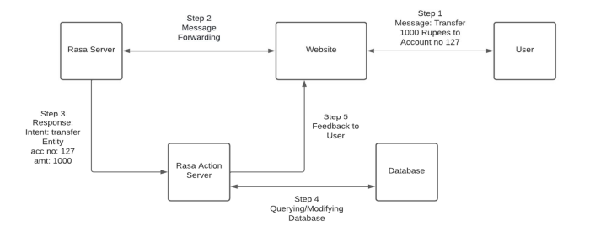
DETAILED DESIGN
SYSTEM ARCHITECTURE:

Slide 12
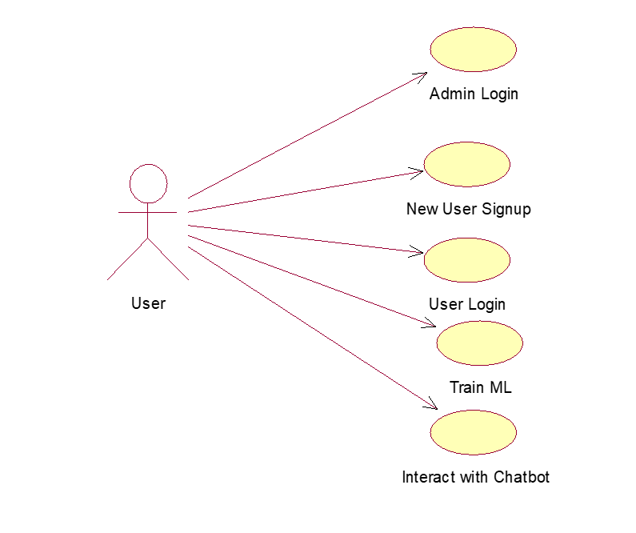
DETAILED DESIGN
USE CASE DAIGARM:

Slide 13
FLOW CHART
ACTIVITY FLOW:
Start
Admin Login
User Login
Train ML
Interact with Chatbot
END

Slide 14
FLOW CHART
DATA FLOW:
User
1. Admin Login 2.Admin Login successfully
3. New User Sign UP 4. New User Sign UP successfully
5. User Login 6. User Login Successfull
7. Train ML 8. Train ML Successfully
9. Interact with Chatbot 10. Successfully Interact with Chatbot
System

Slide 15
ALGORITHMS
K-NEAREST NEIGHBORS (KNN):
The KNN algorithm works by finding the K nearest neighbors to a given data point based on a distance metric, such as Euclidean distance. The class or value of the data point is then determined by the majority vote or average of the K neighbors.
DISADVANTAGES:
1.Does not scale
2.Curse of dimensionality
3.Prone to Over fitting

Slide 16
ALGORITHMS
KNN-STEPS:
1.Data Collection: Gather historical data from past customer interactions and transactions.
This could include chat history, transaction amounts, customer profiles, and account activities.
2.Data Preprocessing: Clean the data to handle missing values, normalize numerical features (like account balances or transaction amounts), and encode categorical features (e.g., customer type, chat responses) into numerical formats.
3.Defining Distance Metric: Use a distance metric (typically Euclidean distance) to measure the similarity between data points. For banking, features like transaction behavior, time of interaction, or product preferences can be used to compute distance between customers.

Slide 17
ALGORITHMS
4.Finding the K Nearest Neighbors: For any given new query (e.g., a new customer request or transaction), the algorithm searches the dataset for the K closest neighbors based on the defined distance metric. The value of K is chosen through cross-validation.
5.Prediction or Recommendation: Based on the majority label (for classification tasks like fraud detection) or the average value (for regression tasks like transaction amount prediction) of the K neighbors, the algorithm provides the predicted response or recommendation, such as product suggestions or flagging suspicious transactions.

Slide 18
ALGORITHMS
RANDOM FOREST :
This randomness introduces variability among individual trees, reducing the risk of overfitting and improving overall prediction performance. In prediction, the algorithm aggregates the results of all trees, either by voting (for classification tasks) or by averaging (for regression tasks).
ADVANTAGES:
1. Resistance to Overfitting
2. Large Datasets Handling
3. High Predictive Accuracy

Slide 19
ALGORITHMS
RANDOM FOREST-STEPS:
1.Data Preparation & Feature Selection
Collect customer data like transaction history, demographics, and interactions with the banking platform.
2. Create Multiple Decision Trees (Bootstrap Sampling)
Randomly select subsets of the data (with replacement) to create multiple decision trees. Each tree is trained on a different subset, ensuring variety and reducing bias.
3. Train Decision Trees Independently
Each decision tree learns from its subset of data and makes predictions independently.

Slide 20
ALGORITHMS
4.Aggregate Predictions (Ensemble Approach)
For classification tasks (e.g., predicting fraud), each tree casts a "vote" for the outcome. The majority vote across all trees becomes the final prediction.
For regression tasks (e.g., predicting loan default probability), the average of the predictions from all trees is taken.
5. Model Evaluation & Optimization
Evaluate the model performance using accuracy, precision, recall, or other relevant metrics.

Slide 21
ALGORITHMS
SUPPORT VECTOR MACHINE:
SVM is particularly useful for classifying large datasets where data points are difficult to separate, as it tries to find the optimal boundary (or "hyperplane") that best distinguishes different financial events, such as fraud detection or credit scoring.
SVM STEPS:
1.Data Collection & Preprocessing:
Gather financial transaction data from various sources like customer records, bank statements, and ERP systems. Clean and preprocess this data to remove noise, missing values, and irrelevant information.

Slide 22
ALGORITHM
2.Feature Extraction
Extract important features from the transaction data. These features could include transaction amounts, dates, account types, and other relevant financial indicators.
3.SVM Model Training
Use the preprocessed and feature-extracted data to train the SVM model.
4.Prediction and Classification
Once trained, the SVM model is applied to new, unseen data. It classifies each transaction based on the hyperplane, predicting whether it belongs to a particular class.

Slide 23
ALGORITHM
5.Continuous Learning and Optimization
ChatFin leverages self-learning AI to improve its predictions over time. The model is continuously updated with new financial data to refine the hyperplane and make more accurate future predictions.

Slide 24
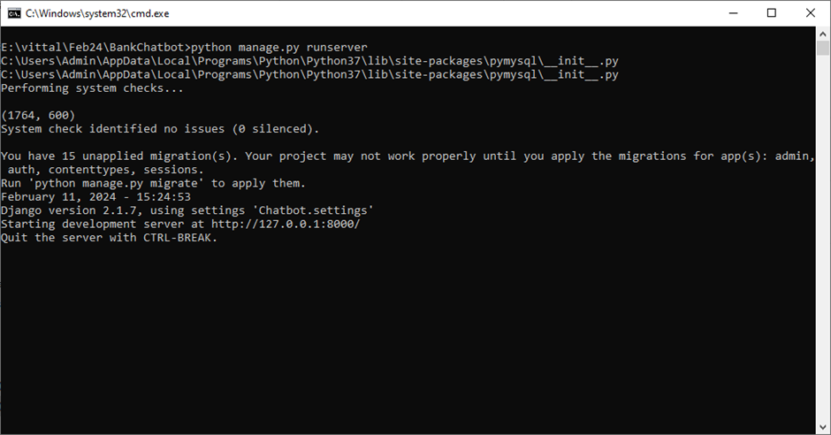
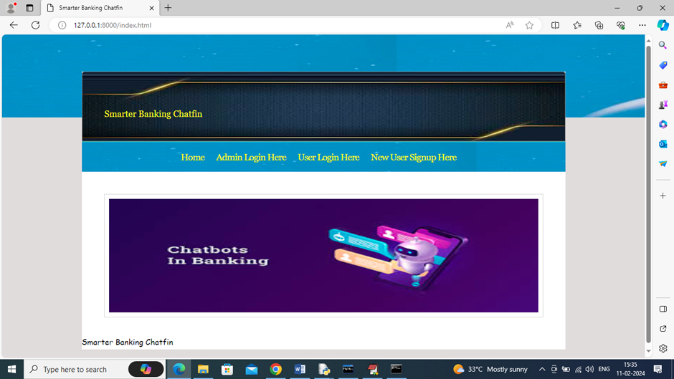
RESULT OBTAINED

Slide 25
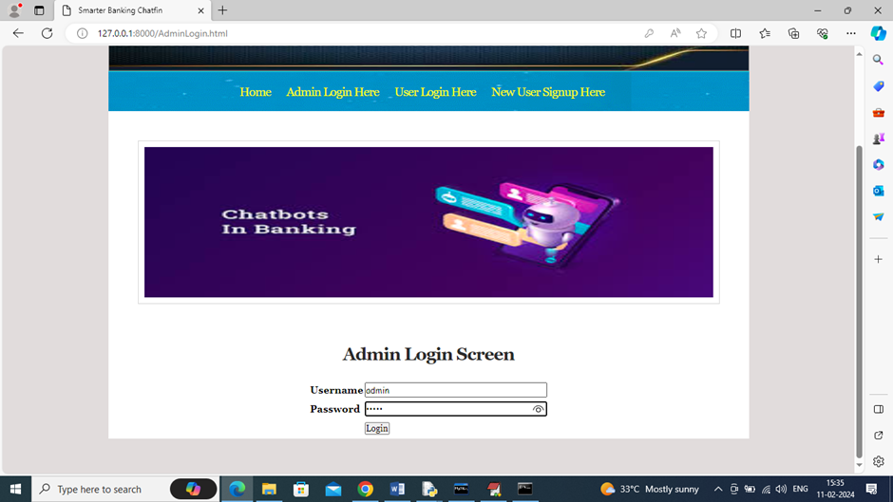
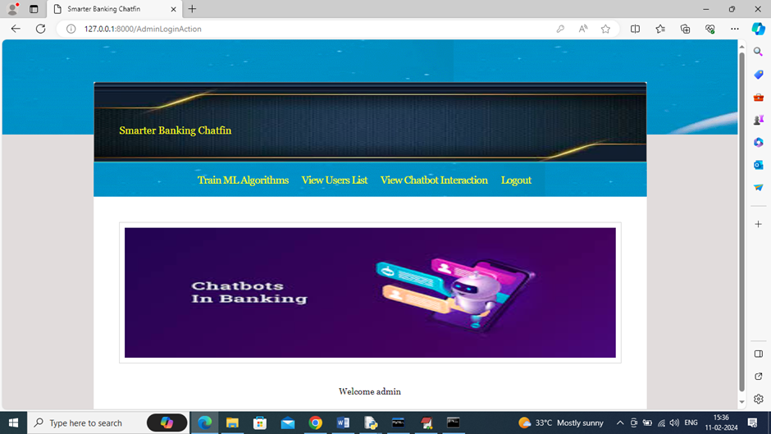
RESULT OBTAINED

Slide 26
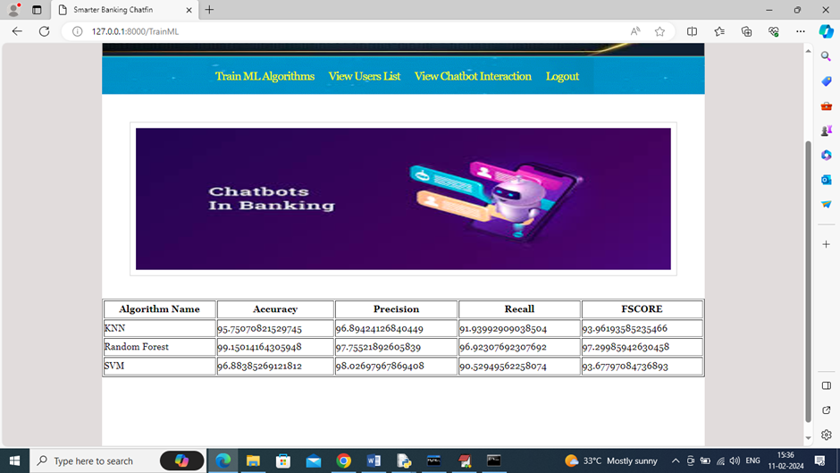
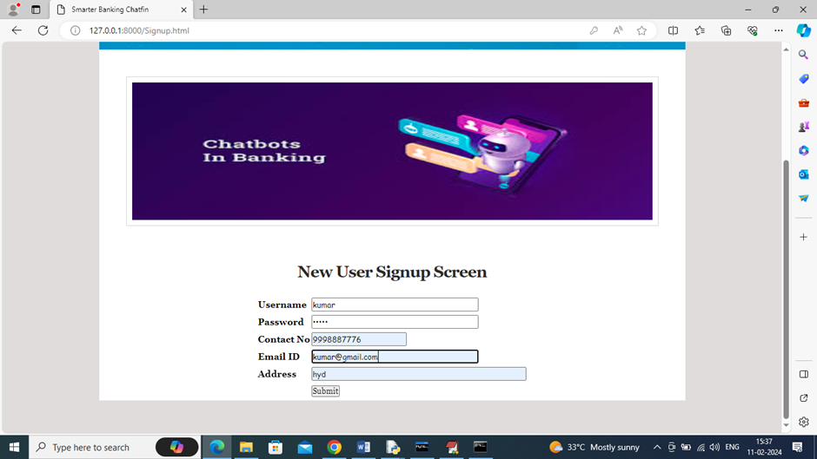
RESULT OBTAINED

Slide 27

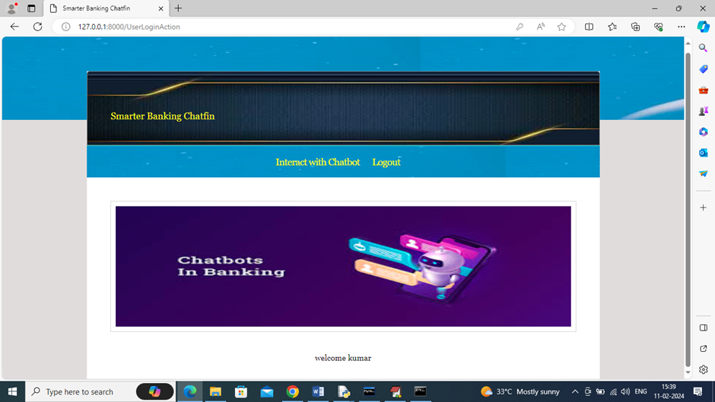
RESULT OBTAINED

Slide 28
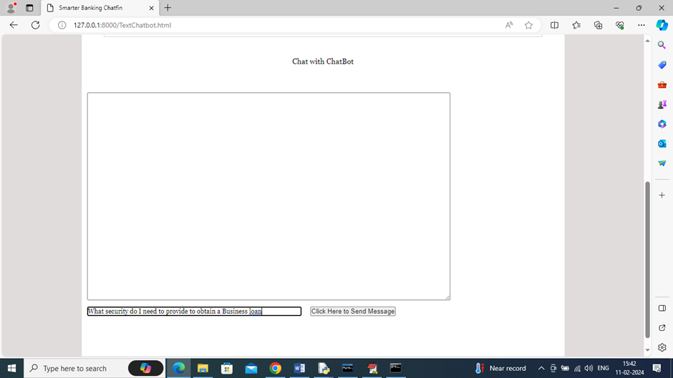
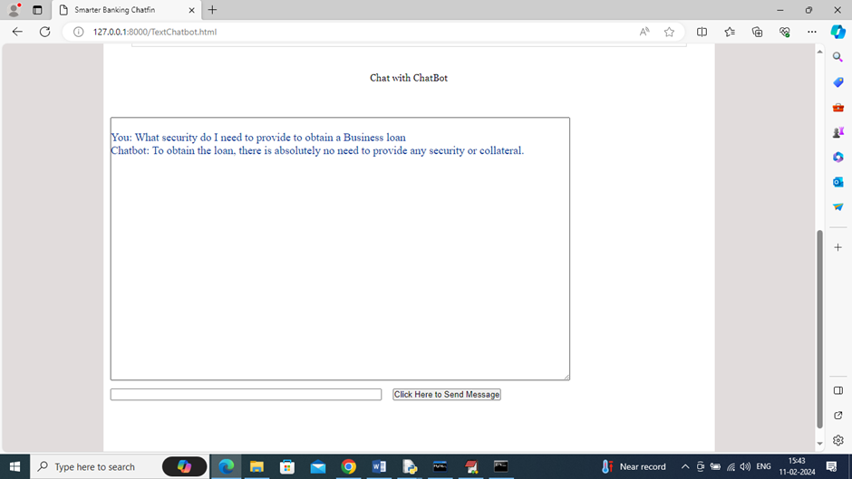
RESULT OBTAINED

Slide 29
PYTHON MODULES
NumPy(1.19.2): A powerful library for numerical computing in Python, offering support for large, multi-dimensional arrays and matrices, along with a collection of mathematical functions to operate on them. It also has functions for working in domain of linear algebra, Fourier transform, and matrices.
Pandas(0.25.3): A powerful data manipulation and analysis library in Python, offering data structures like DataFrames for handling structured data efficiently. It has functions for analysing, cleaning, exploring, and manipulating data.
sklearn (scikit-learn(1.0.2)):A machine learning library in Python that provides simple and efficient tools for data mining and data analysis, built on NumPy, SciPy, and matplotlib.

Slide 30
PYTHON MODULES
PyMySQL(0.9.3): PyMySQL is a Python library used to interact with MySQL databases. It allows you to connect, query, and manage databases directly from Python code.
Django(2.1.7): Django is a high-level Python web framework designed for rapid development and clean, pragmatic design. It provides tools for handling database operations, templating, routing, and authentication, making it easy to build robust web applications.
NLTK(3.4.5):NLTK (Natural Language Toolkit) is a powerful Python library used for natural language processing (NLP) tasks. It provides tools for text processing, such as tokenization, stemming, tagging, parsing, and semantic reasoning, along with access to various corpora and lexical resources.

Slide 31
CODE
from django.shortcuts import render
from django.template import RequestContext
from django.contrib import messages
from django.http import HttpResponse
import os
import pandas as pd
import numpy as np
import pickle
from sklearn.feature_extraction.text import TfidfVectorizer
import pymysql
from numpy import dot
from numpy.linalg import norm
from django.core.files.storage import FileSystemStorage
from datetime import date
from string import punctuation
from nltk.corpus import stopwords
import nltk
from nltk.stem import WordNetLemmatizer
from nltk.stem import PorterStemmer
from sklearn.model_selection import train_test_split
from sklearn.feature_extraction.text import TfidfVectorizer
from sklearn.preprocessing import LabelEncoder
from sklearn.metrics import accuracy_score
from sklearn.metrics import precision_score
from sklearn.metrics import recall_score
from sklearn.metrics import f1_score
from sklearn.preprocessing import LabelEncoder
from sklearn.preprocessing import StandardScaler
from sklearn.neighbors import KNeighborsClassifier
from numpy import dot
from numpy.linalg import norm
from sklearn.ensemble import RandomForestClassifier
from sklearn import svm
global uname, tfidf_vectorizer, scaler
global X_train, X_test, y_train, y_test
accuracy, precision, recall, fscore = [], [], [], []

Slide 32
CODE
global uname, tfidf_vectorizer, scaler
global X_train, X_test, y_train, y_test
accuracy, precision, recall, fscore = [], [], [], []
dataset = pd.read_csv("Dataset/BankFAQs.csv")
dataset = dataset.dropna()
question = []
answer = []
Y = []
labels = np.unique(dataset['Class'])
le = LabelEncoder()
dataset['Class'] = pd.Series(le.fit_transform(dataset['Class'].astype(str)))
Y = dataset['Class']
dataset = dataset.values
#define object to remove stop words and other text processing
stop_words = set(stopwords.words('english'))
lemmatizer = WordNetLemmatizer()
ps = PorterStemmer()
def cleanText(doc):
tokens = doc.split()
table = str.maketrans('', '', punctuation)
tokens = [w.translate(table) for w in tokens]
tokens = [word for word in tokens if word.isalpha()]
tokens = [w for w in tokens if not w in stop_words]
tokens = [word for word in tokens if len(word) > 1]
tokens = [ps.stem(token) for token in tokens]
tokens = [lemmatizer.lemmatize(token) for token in tokens]
tokens = ' '.join(tokens)
return tokens
question = np.load("model/question.npy")
answer = np.load("model/answer.npy")
Y = np.load("model/Y.npy")
tfidf_vectorizer = TfidfVectorizer(stop_words=stop_words, =True, smooth_idf=False, norm=None, decode _error='replace', max_features=600)
tfidf_X = tfidf_vectorizer.fit_transform(question).toarray()
print(tfidf_X.shape)

Slide 33
CODE
X = tfidf_X
X_train, X_test, y_train, y_test = train_test_split(X, Y, test_size=0.2) #split data into train & test
X_train, X_test1, y_train, y_test1 = train_test_split(X, Y, test_size=0.1) #split data into train & test
def calculateMetrics(algorithm, predict, y_test):
global accuracy, precision, recall, fscore
a = accuracy_score(y_test,predict)*100
p = precision_score(y_test, predict,average='macro') * 100
r = recall_score(y_test, predict,average='macro') * 100
f = f1_score(y_test, predict,average='macro') * 100
accuracy.append(a)
precision.append(p)
recall.append(r)
fscore.append(f)
knn = KNeighborsClassifier(n_neighbors=2)
knn.fit(X_train, y_train)
predict = knn.predict(X_test)
calculateMetrics("KNN", predict, y_test)
rf = RandomForestClassifier()
rf.fit(X_train, y_train)
predict = rf.predict(X_test)
calculateMetrics("Random Forest", predict, y_test)
svm_cls = svm.SVC()
svm_cls.fit(X_train, y_train)
predict = svm_cls.predict(X_test)
calculateMetrics("SVM", predict, y_test)
def TextChatbot(request):
if request.method == 'GET':
return render(request, 'TextChatbot.html', {})
def TrainML(request):
if request.method == 'GET':
output = ''
output+='<table border=1 align=center width=100%><tr><th><font size="" color="black">Algorithm Name</th><th><font size="" color="black">Accuracy</th><th><font size="" color="black">Precision</th>'

Slide 34
CODE
global accuracy, precision, recall, fscore
algorithms = ['KNN', 'Random Forest', 'SVM']
for i in range(len(algorithms)):
output+='<td><font size="" color="black">'+algorithms[i]+'</td><td><font size="" color="black">'+str(accuracy[i])+'</td><td><font size="" color="black">'+str(precision[i])+'</td><td><font size="" color="black">'+str(recall[i])+'</td><td><font size="" color="black">'+str(fscore[i])+'</td></tr>'
output+= "</table></br></br></br></br>"
context= {'data':output}
return render(request, 'AdminScreen.html', context)
def UpdateStatus(request):
if request.method == 'GET':
lid = request.GET['lid']
status = request.GET['status']
db_connection = pymysql.connect(host='127.0.0.1',port = 3306,user = 'root', password = 'root', database = 'BankChatbot',charset='utf8')
db_cursor = db_connection.cursor()
student_sql_query = "update loan set status='"+status+"' where loan_id='"+lid+"'"
db_cursor.execute(student_sql_query)
db_connection.commit()
context= {'data':'Application Status successfully Updated : '+status}
return render(request, 'AdminScreen.html', context)
def ViewApplications(request):
if request.method == 'GET':
output = ''
output+='<table border=1 align=center width=100%><tr><th><font size="" color="black">Application ID</th><th><font size="" color="black">Applicant Name</th>'
output+='<th><font size="" color="black">Loan Purpose</th><th><font size="" color="black">Amount</th><th><font size="" color="black">Pan No</th>'
output+='<th><font size="" color="black">Aadhar No</th><th><font size="" color="black">Applied Date</th>'
output+='<th><font size="" color="black">Status</th><th><font size="" color="black">Accept Application</th><th><font size="" color="black">Reject Application</th></tr>'

Slide 35
CODE
cur = con.cursor()
cur.execute("select * from loan where status='Pending'")
rows = cur.fetchall()
output+='<tr>'
for row in rows:
output+='<td><font size="" color="black">'+str(row[0])+'</td><td><font size="" color="black">'+str(row[1])+'</td>'
output+='<td><font size="" color="black">'+row[2]+'</td><td><font size="" color="black">'+row[3]+'</td><td><font size="" color="black">'+row[4]+'</td>'
output += '<td><font size="" color="black">'+row[5]+'</td>'
output += '<td><font size="" color="black">'+row[6]+'</td><td><font size="" color="black">'+row[7]+'</td>'
output+='<td><a href=\'UpdateStatus?lid='+str(row[0])+'&status=Accepted\'><font size=3 color=black>Click Here to Accept</font></a></td>'
output+='<td><a href=\'UpdateStatus?lid='+str(row[0])+'&status=Rejected\'><
font size=3 color=black>Click Here to Reject</font></a></td></tr>'
output+= "</table></br></br></br></br>"
context= {'data':output}
return render(request, 'AdminScreen.html', context)
def ApplyLoan(request):
if request.method == 'GET':
return render(request, 'ApplyLoan.html', {})
def ApplyLoanAction(request):
if request.method == 'POST':
global uname
purpose = request.POST.get('t1', False)
amount = request.POST.get('t2', False)
pan = request.POST.get('t3', False)
aadhar = request.POST.get('t4', False)
today = str(date.today())
loan_id = 0
con = pymysql.connect(host='127.0.0.1',port = 3306,user = 'root', password = 'root', database = 'BankChatbot',charset='utf8')

Slide 36
CODE
with con:
cur = con.cursor()
cur.execute("select max(loan_id) FROM loan")
rows = cur.fetchall()
for row in rows:
loan_id = row[0]
if loan_id is not None:
loan_id += 1
else:
loan_id = 1
db_connection = pymysql.connect(host='127.0.0.1',port = 3306,user = 'root', password = 'root', database = 'BankChatbot',charset='utf8')
db_cursor = db_connection.cursor()
student_sql_query = "INSERT INTO loan(loan_id,username,loan_purpose,amount,pan_no,aadhar_no,applied_date,status) VALUES('"+str(loan_id)+"','"+uname+"','"+purpose+"','"+amount+"','"+pan+"','"+aadhar+"','"+today+"','Pending')"
db_cursor.execute(student_sql_query)
db_connection.commit()
context= {'data':'Your Application submitted successfully with ID : '+str(loan_id)+"<br/>Our Admin will reply"}
return render(request, 'ApplyLoan.html', context)
def saveInteraction(user_question, output):
global uname
today = str(date.today())
interact_id = 0
con = pymysql.connect(host='127.0.0.1',port = 3306,user = 'root', password = 'root', database = 'BankChatbot',charset='utf8')
with con:
cur = con.cursor()
cur.execute("select max(interact_id) FROM interaction")
rows = cur.fetchall()
for row in rows:
interact_id = row[0]
if interact_id is not None:
interact_id += 1
else:
interact_id = 1

Slide 37
CODE
db_connection = pymysql.connect(host='127.0.0.1',port = 3306,user = 'root', password = 'root', database = 'BankChatbot',charset='utf8')
db_cursor = db_connection.cursor()
student_sql_query = "INSERT INTO interaction(interact_id,username,question,answer,interact_date) VALUES('"+str(interact_id)+"','"+uname+"','"+user_question+"','"+output+"','"+today+"')"
db_cursor.execute(student_sql_query)
db_connection.commit()
def ChatData(request):
if request.method == 'GET':
global answer, tfidf_vectorizer, X, question, scaler
user_question = request.GET.get('mytext', False)
query = user_question
print(query)
query = query.strip().lower()
query = cleanText(query)#clean description
testData = tfidf_vectorizer.transform([query]).toarray()
testData = testData[0]
print(testData.shape)
output = "Sorry! unable to answer"
index = -1
max_accuracy = 0
for i in range(len(X)):
predict_score = dot(X[i], testData)/(norm(X[i])*norm(testData))
if predict_score > max_accuracy:
max_accuracy = predict_score
index = i
if index != -1:
output = answer[index]
saveInteraction(user_question, output)
print(output)
return HttpResponse("Chatbot: "+output, content_type="text/plain")

Slide 38
CODE
def AddQuestion(request):
if request.method == 'GET':
return render(request, 'AddQuestion.html', {})
def Signup(request):
if request.method == 'GET':
return render(request, 'Signup.html', {})
def index(request):
if request.method == 'GET':
return render(request, 'index.html', {})
def UserLogin(request):
if request.method == 'GET':
return render(request, 'UserLogin.html', {})
def AdminLogin(request):
if request.method == 'GET':
return render(request, 'AdminLogin.html', {})
def AdminLoginAction(request):
if request.method == 'POST':
global userid
user = request.POST.get('t1', False)
password = request.POST.get('t2', False)
if user == "admin" and password == "admin":
context= {'data':'Welcome '+user}
return render(request, 'AdminScreen.html', context)
else:
context= {'data':'Invalid Login'}
return render(request, 'AdminLogin.html', context)
def UserLoginAction(request):
if request.method == 'POST':
global uname
username = request.POST.get('t1', False)
password = request.POST.get('t2', False)
index = 0

Slide 39
CODE
con = pymysql.connect(host='127.0.0.1',port = 3306,user = 'root', password = 'root', database = 'BankChatbot',charset='utf8')
with con:
cur = con.cursor()
cur.execute("select * FROM register")
rows = cur.fetchall()
for row in rows:
if row[0] == username and password == row[1]:
uname = username
index = 1
break
if index == 1:
context= {'data':'welcome '+username}
return render(request, 'UserScreen.html', context)
else:
context= {'data':'login failed'}
return render(request, 'UserLogin.html', context)
def SignupAction(request):
if request.method == 'POST':
username = request.POST.get('t1', False)
password = request.POST.get('t2', False)
contact = request.POST.get('t3', False)
email = request.POST.get('t4', False)
address = request.POST.get('t5', False)
status = "none"
con = pymysql.connect(host='127.0.0.1',port = 3306,user = 'root', password = 'root', database = 'BankChatbot',charset='utf8')
with con:
cur = con.cursor()
cur.execute("select * FROM register")
rows = cur.fetchall()
for row in rows:
if row[0] == username:
status = "Username already exists"

Slide 40
CODE
if status == "none":
db_connection = pymysql.connect(host='127.0.0.1',port = 3306,user = 'root', password = 'root', database = 'BankChatbot',charset='utf8')
db_cursor = db_connection.cursor()
student_sql_query = "INSERT INTO register(username,password,contact,email,address) VALUES('"+username+"','"+password+"','"+contact+"','"+email+"','"+address+"')"
db_cursor.execute(student_sql_query)
db_connection.commit()
print(db_cursor.rowcount, "Record Inserted")
if db_cursor.rowcount == 1:
status = "Signup Process Completed. You can Login now"
context= {'data': status}
return render(request, 'Signup.html', context)
def ViewUser(request):
if request.method == 'GET':
output = ''
output+='<table border=1 align=center width=100%><tr><th><font size="" color="black">Username</th><th><font size="" color="black">Password</th><th><font size="" color="black">Contact No</th>'
output+='<th><font size="" color="black">Email ID</th><th><font size="" color="black">Address</th></tr>'
con = pymysql.connect(host='127.0.0.1',port = 3306,user = 'root', password = 'root', database = 'BankChatbot',charset='utf8')
with con:
cur = con.cursor()
cur.execute("select * from register")
rows = cur.fetchall()
output+='<tr>'
for row in rows:
output+='<td><font size="" color="black">'+row[0]+'</td><td><font size="" color="black">'+str(row[1])+'</td><td><font size="" color="black">'+row[2]+'</td><td><font size="" color="black">'+row[3]+'</td><td><font size="" color="black">'+row[4]+'</td></tr>'

Slide 41
CODE
context= {'data':output}
return render(request, 'AdminScreen.html', context)
def viewChats(request):
if request.method == 'GET':
output = ''
output+='<table border=1 align=center width=100%><tr><th><font size="" color="black">Interaction ID</th><th><font size="" color="black">Username</th><th><font size="" color="black">Question</th>'
output+='<th><font size="" color="black">Chatbot Answer</th><th><font size="" color="black">Interaction Date</th></tr>'
con = pymysql.connect(host='127.0.0.1',port = 3306,user = 'root', password = 'root', database = 'BankChatbot',charset='utf8')
with con:
cur = con.cursor()
cur.execute("select * from interaction")
rows = cur.fetchall()
output+='<tr>'
for row in rows:
output+='<td><font size="" color="black">'+str(row[0])+'</td><td><font size="" color="black">'+str(row[1])+'</td><td><font size="" color="black">'+row[2]+'</td><td><font size="" color="black">'+row[3]+'</td><td><font size="" color="black">'+row[4]+'</td></tr>'
output+= "</table></br></br></br></br>"
context= {'data':output}
return render(request, 'AdminScreen.html', context)
def ViewStatus(request):
if request.method == 'GET':
global uname
output = ''
output+='<table border=1 align=center width=100%><tr><th><font size="" color="black">Application ID</th><th><font size="" color="black">Applicant Name</th>'
output+='<th><font size="" color="black">Loan

Slide 42
CODE
output+='<th><font size="" color="black">Aadhar No</th><th><font size="" color="black">Applied Date</th>'
output+='<th><font size="" color="black">Status</th></tr>'
con = pymysql.connect(host='127.0.0.1',port = 3306,user = 'root', password = 'root', database = 'BankChatbot',charset='utf8')
with con:
cur = con.cursor()
cur.execute("select * from loan where username='"+uname+"'")
rows = cur.fetchall()
output+='<tr>'
for row in rows:
output+='<td><font size="" color="black">'+str(row[0])+'</td><td><font size="" color="black">'+str(row[1])+'</td>'
output+='<td><font size="" color="black">'+row[2]+'</td><td><font size="" color="black">'+row[3]+'</td><td><font size="" color="black">'+row[4]+'</td>'
output+='<th><font size="" color="black">Aadhar No</th><th><font size="" color="black">Applied Date</th>'
output+='<th><font size="" color="black">Status</th></tr>'
con = pymysql.connect(host='127.0.0.1',port = 3306,user = 'root', password = 'root', database = 'BankChatbot',charset='utf8')
with con:
cur = con.cursor()
cur.execute("select * from loan where username='"+uname+"'")
rows = cur.fetchall()
output+='<tr>'
for row in rows:
output+='<td><font size="" color="black">'+str(row[0])+'</td><td><font size="" color="black">'+str(row[1])+'</td>'
output+='<td><font size="" color="black">'+row[2]+'</td><td><font size="" color="black">'+row[3]+'</td><td><font size="" color="black">'+row[4]+'</td>'

Slide 43
CODE
color="black">'+row[7]+'</td></tr>'
output+= "</table></br></br></br></br>"
context= {'data':output}
return render(request, 'UserScreen.html', context)

Slide 44
REFERENCES
[1] Jiao, Anran. (2020). An Intelligent Chatbot System Based on Entity Extraction Using RASA NLU and Neural Network. Journal of Physics: Conference Series. 1487. 012014. 10.1088/1742-6596/1487/1/012014.
[2] Fathima, Sasha & Student, Suhel & Shukla, Vinod & Vyas, Dr Sonali & Mishra, Ved P. (2020). Conversation to Automation in Banking Through Chatbot Using Artificial Machine Intelligence Language. 10.1109/ICRITO48877.2020.9197825.
[3] Singh, Netra & Singh, Devender. (2019). Chatbots and Virtual Assistant in Indian Banks. Industrija. 47. 75-101. 10.5937/industrija47-24578.

Slide 45
REFERENCES
[4] Petr Lorenc, “Joint model for intent and entity recognition” in arXiv:2109.03221v1 [cs.CL] 7 Sep 2021
[5] Bank, C. (2018, 01 19). Commonwealth Bank launches chatbot named Ceba. Retrieved from Commonwealth Bank launches chatbot named Ceba: https://www.commbank.com.au/ guidance/newsroom/cba-launches-chatbot-named-CEBA-201801.html
[6] Barris, M. (2022). Ally Bank’s in-app virtual assistant speaks customers’ language – literally. Retrieved from https://www.retaildive.com/ex/mobilecommercedaily/ally-banks-in-appvirtual-assistant-speaks-customers-language-literally

Slide 46
THANK YOU

Slide 47
QUERIES ?

